Slide 1
Make your clients’ cash work harder
Manulife Bank deposit products
Notes:
Presenter: Regional Director
Audience: Advisor
Dates and Rates must be updated on the following slides: 5, 9, 13, 14, 15 and 18

Slide 2
Section 2:
Online applications in minutes

Slide 3



Make your clients’ cash work harder
Three key components
– to be completed at once or individually as time permits
Understanding our various deposit options
Discover the benefits of our online application system and how to use it
Learn various sales strategies, customer segments and marketing

Slide 4

Online applications – The 5 minute account opening solution
Advantage Account fits
different client needs
New online application
Notes:
Online application overview and demonstration
Simple and intuitive process
The customer experience
Remind attendees they can post a question at any point during the presentation; you will address all questions at the end.

Slide 5
The issue
$774 billion
sits in bank accounts
$400 billion in zero interest chequing accounts
$374 billion in premium savings accounts
Your clients must
juggle their money to
earn interest on their cash
¹Source: Investor Economics, December 2017 Household Balance Sheet
Notes:
The issue is your clients must juggle their money to earn interest on their cash
744 billion in all chequing and savings accounts*
Premium savings accounts – estimated almost $360 billion
Clients will forego earn interest on their chequing accounts in order to access their money. It’s like giving the bank a loan for free. In fact often clients pay a fee to give their bank their hard earned money for free.
Savings accounts can earn a good short term rate of interest and doesn’t lock in a client’s money like a GIC but most don’t allow the ability to pay bills or purchase items directly from the account.
As a result your clients spend time juggling accounts. Wouldn’t you agree that the way Canadians bank is expensive and inefficient?

Slide 6
The result
Are your clients…
Maximizing their TFSA and RRSP contributions?
Financial protected from disability, illness or death?
Sending their investment and insurance payments from an FI that also provides financial advice?
Complicated banking
impacts clients’ ability
to grow and protect assets
Notes:
100% of clients have a bank account
744 billion in all chequing and savings accounts*
Premium savings accounts – estimated almost $360 billion
Advisors can attract these assets and convert to long term funds if more beneficial to the client
Investments are often personal/Banking is family centric
An estimated $850 billion will transfer through estates in the next decade – proceeds are sent to a bank account
Among widows, 80 per cent switch advisers after the death of their husband.
90% to 95% of offspring leave their parents’ advisors upon receiving their inheritance.

Slide 7
The opportunity
Would you be interested in…
Simplifying your clients’ banking,
Improving their financial plan, and
Growing your business at the same time?
Are you ready to discover how clients can start banking with
you in 5 minutes or less?
Protect your business
and add bank assets
in 5 minutes or less
Notes:
100% of clients have a bank account
744 billion in all chequing and savings accounts*
Premium savings accounts – estimated almost $360 billion
Advisors can attract these assets and convert to long term funds if more beneficial to the client
Investments are often personal/Banking is family centric
An estimated $850 billion will transfer through estates in the next decade – proceeds are sent to a bank account
Among widows, 80 per cent switch advisers after the death of their husband.
90% to 95% of offspring leave their parents’ advisors upon receiving their inheritance.

Slide 8

Key benefits of our new online application
Reasons to use new online application:
Convenience
Fast
Easy-to-use
Instant processing
Immediate funding
Grow your business
  Earn 25 bps income
Notes:
Convenience - Our new online application provides your clients the option of opening a new personal Advantage Account when it’s most convenient for them -- whether they’re at home, on the go or meeting with you.
Speed – In many cases, the application can be completed in less than five minutes – making this process an efficient option for your clients.
Easy to use – Intuitive user interfaces and tips help ensure the application is completed correctly – the first time.
Instant processing – In most cases, a new account can be opened and operational immediately after the application is completed. Once an account is open, the client can use the password they create during the application process, along with the access code we’ll assign them in real-time, to begin banking online or by using our mobile banking app.
Immediate funding – Clients can use our mobile deposit feature to fund a new account from their smartphones or tablets immediately after the set-up process.
Grow your business – Our new application process allows you to easily reach more clients -- with little administration work required.

Slide 9

Three easy steps to better banking
1
2
3
Share your custom online
application webpage
Have your client
complete the application
Help your client
simplify and save

Slide 10

Share your custom online application webpage
1
Your selling code creates a custom link
Share your link with clients
  Send an email (we have templates)
  Place link on your web site
  Distribute your link through social media
  Use the application when clients visit your office
Notes:
Advantage Account has many uses and can serve many client needs

Slide 11
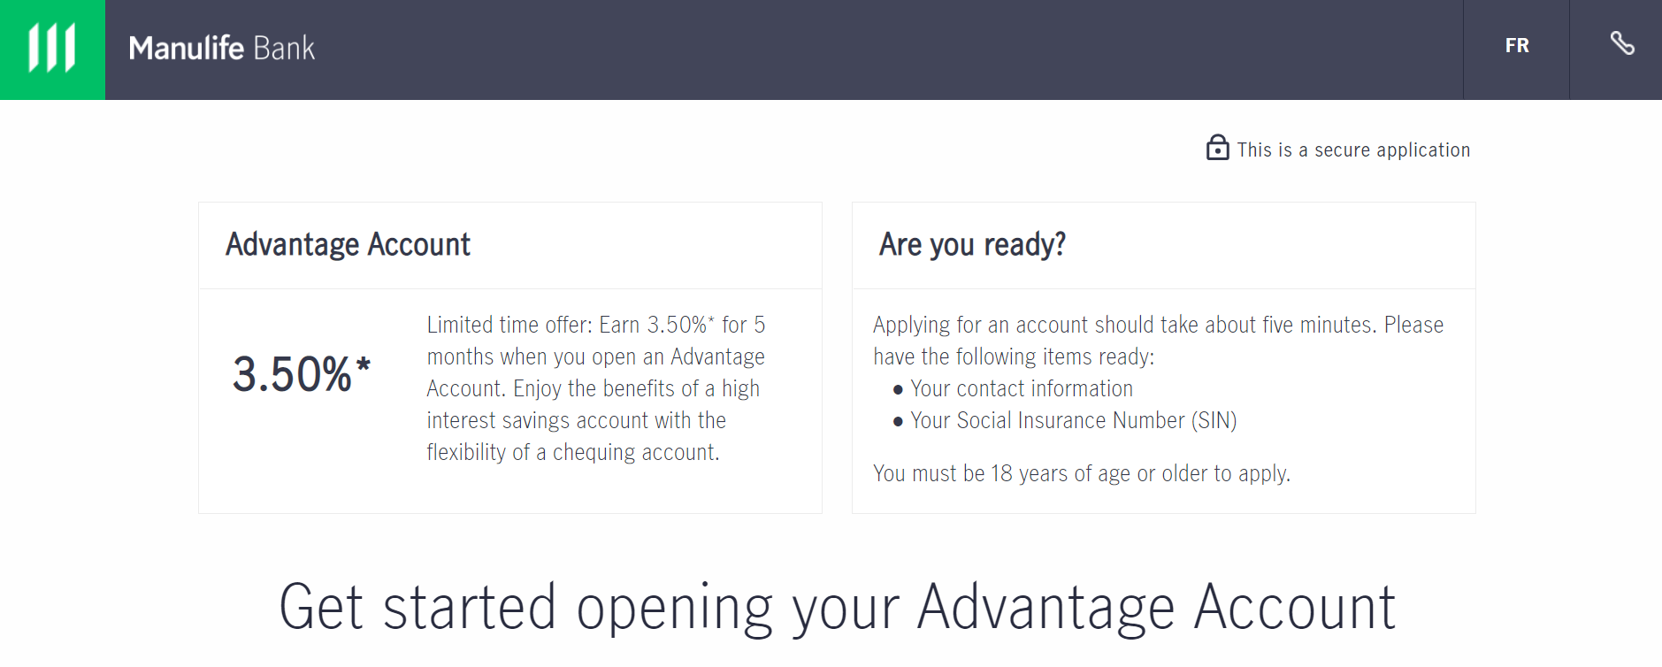
‘Open an account with us’ in
5 minutes or less
2
Recommended by: Joe advisor
Recommended by: John Smith
Your name appears in the “Recommended by” section
Our posted rate or a promotional rate appears on your webpage
Simple & intuitive interface
Notes:
Your name appears in the “Recommended by” section
Either our posted rate or an occasional promotional rate will appear on your webpage
Simple & intuitive interface
Mobile friendly design
Fewer, simplified onboarding questions
AddressComplete from Canada Post
Equifax for ID verification

Slide 12
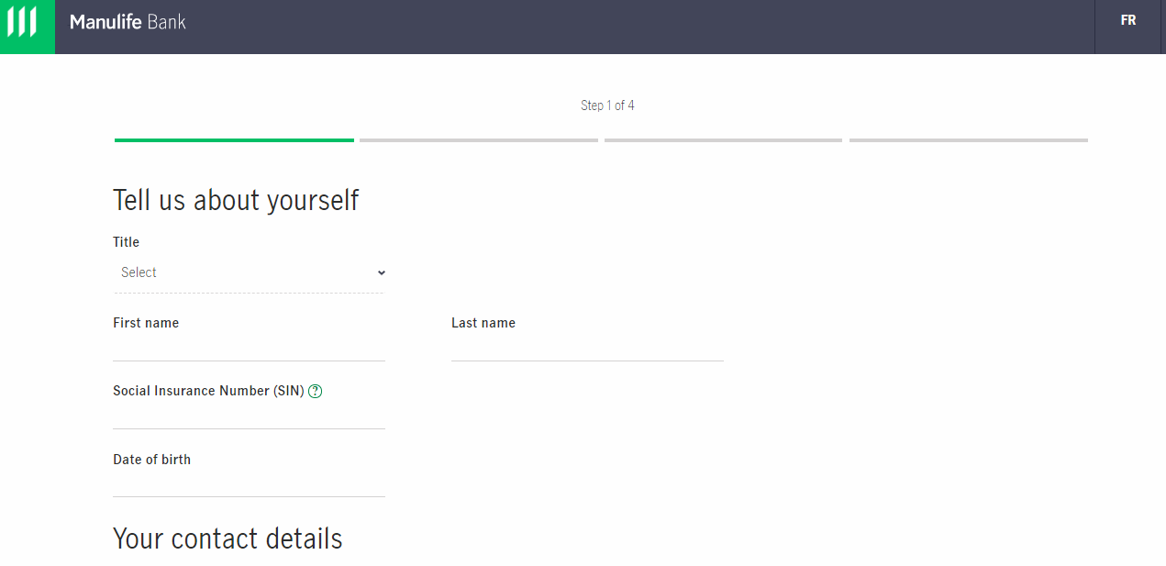
5 minutes or less with just 5 application sections:
1. ‘About you’
Recommended by: Joe advisor
Recommended by: John Smith
Name and contact details
Social Insurance Number (SIN) is required for tax purposes
AddressComplete verifies address
Notes:
Name and contact details
Social Insurance Number (SIN) is required for tax purposes
AddressComplete from Canada Post will verify address/auto-populate fields

Slide 13
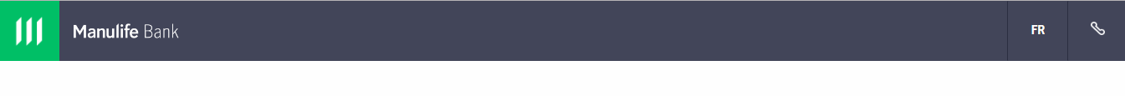
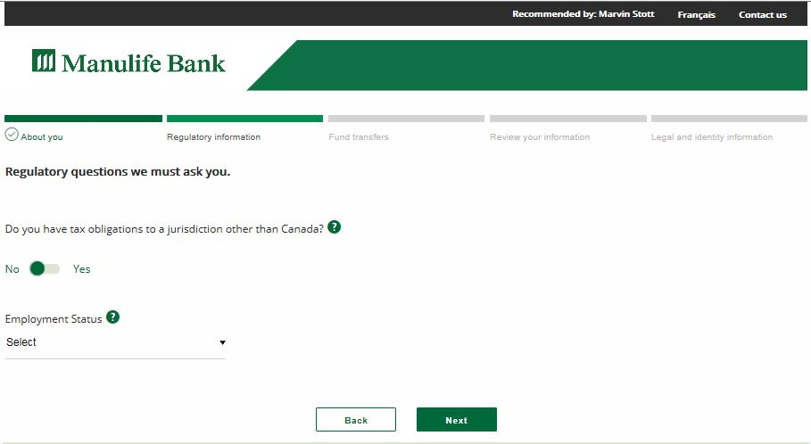
5 minutes or less with just 5 application sections:
2. ‘Regulatory information’
Recommended by: Joe advisor
Recommended by: John Smith
Step 2 of 4
Are there tax obligations outside Canada?
Employment status and occupation selection is easier
Notes:
Are there tax obligations outside Canada?
Employment status is required even if retired
Drop-down menu of occupations make it easier

Slide 14
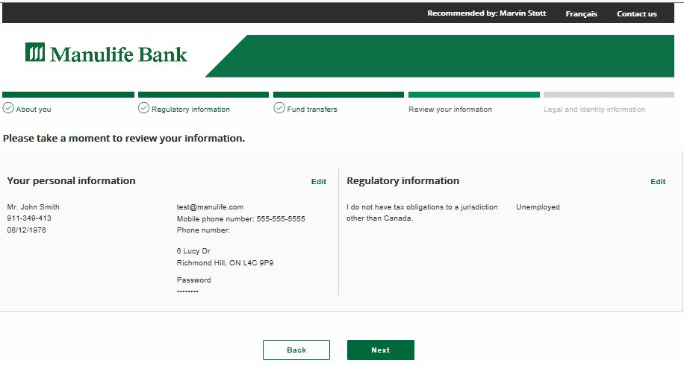
5 minutes or less with just 5 application sections:
3. ‘Review your information’
Step 3 of 4

Slide 15
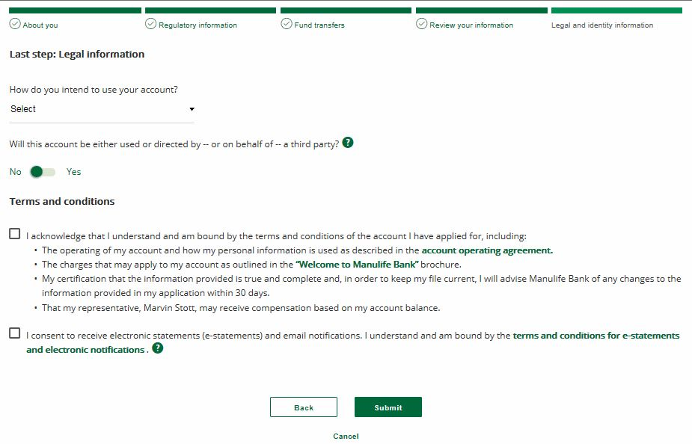

5 minutes or less with just 5 application sections:
4. ‘Legal and identity information’
Step 4 of 4
Uses for client ID verification
  Does not affect credit score

Slide 16
Help your client simplify and save
3
No need to bank elsewhere
Second largest Canadian ABM network
Easy online and industry leading mobile banking
  Mobile Deposit for cheques, access card Interac Flash® tap purchases and voice passwords, etc.
Ranked among the best for client service
Balance of $1,000+ | Balance less than $1,000
Unlimited free banking | Free pre-authorized payments, fund transfers, cheque-writing and online access
 | Review fee schedule for other transactions

Slide 17

Account funding options
Mobile cheque deposit – Recommended!
Mail a cheque
ABM deposit
RBC deposit slips (if required)
Notes:
Same account funding options, but some have additional advantages:
Mobile cheque deposit
Fast
Automatically links account
Mail a cheque
Slow
Automatically links account
Automated banking machine deposit
Slow
Doesn’t automatically link account
1+ week wait for access card
Advisor bank deposit is not recommended
Moderate to slow
Doesn’t automatically link account
Relies on advisor & Manulife Bank processing

Slide 18
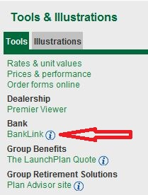
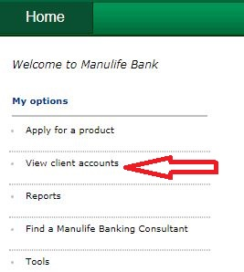
How to know your clients have opened an account
BankLink
View client accounts or run a report
Notes:
Same account funding options, but some have additional advantages:
Mobile cheque deposit
Fast
Automatically links account
Mail a cheque
Slow
Automatically links account
Automated banking machine deposit
Slow
Doesn’t automatically link account
1+ week wait for access card
Advisor bank deposit is not recommended
Moderate to slow
Doesn’t automatically link account
Relies on advisor & Manulife Bank processing

Slide 19
Thank you
Notes:
Presenter: Regional Director
Audience: Advisor
Dates and Rates must be updated on the following slides: 4, 8, 10, 13, 14, 15, 16 and 19

Slide 20
Important information
Manulife Bank of Canada is a member of the Canada Deposit Insurance Corporation.
Manulife, Manulife Bank & Stylized M Design, and Stylized M Design are trademarks of The Manufacturers Life Insurance Company and are used by it, and by its affiliates under license

