Slide 1
Make your clients’ cash work harder
Manulife Bank deposit products
Notes:
Presenter: Regional Director
Audience: Advisor
Dates and Rates must be updated on the following slides: 5, 9, 13, 14, 15 and 18

Slide 2
Section #3:
Marketing and sales strategies to grow your business

Slide 3



Make your clients’ cash work harder
Three key components
– to be completed at once or individually as time permits
Understanding our various deposit options
Discover the benefits of our online application system and how to use it
Learn various sales strategies, customer segments and marketing

Slide 4

RECAP
$774 billion sits in bank accounts
  $400 billion in zero interest chequing accounts
Your clients’ banking institutions also cross-sell products you provide
We’ve create a unique web page for your clients
In 5 minutes or less we can give your clients better banking solutions and build your business
¹Source: Investor Economics, December 2017 Household Balance Sheet

Slide 5

Advantage Account Fits Different Client Needs
All-in-one Savings
and Everyday Bank
Bucket
Savings
Cash
Management
Estate
Planning
Children’s
accounts

Slide 6

MANULIFE BANK ADVANTAGE ACCOUNT¹
HOW IS IT ALL-IN-ONE?
IT’S A SAVINGS ACCOUNT
IT’S A CHEQUING ACCOUNT
3.50%* interest rate
Daily high interest-rate on every dollar
FREE Transfers:
Unlimited free fund transfers to move your money to and from your accounts at other Canadian financial institutions
Safety:
Manulife is a trusted household name an your deposits are eligible for the protection of CDIC deposit insurance
FREE banking:
Maintain a monthly balance of just $1,000 or more for unlimited, no-fee everyday banking
Easy access:
Use your debit card to access cash at Canada’s second largest ABM Network or make Interac® purchases and e-transfers.
Online and mobile banking
Pay bills, deposit cheques and manage your money on the go
* 3.50% promotional rate is for new deposits to a new personal, non-registered, Canadian-dollar Advantage Account. The promotional interest rate is made up of the regular posted annual variable interest rate of 1.75% and the variable annual promotional rate of 1.75%. Interest is calculated daily and paid monthly beginning on the date the account is opened and continuing 150 days (5 months) on net new deposits to a maximum of $500,000. Any change to the regular interest rate will result in a corresponding change to the promotional interest rate. The offer is limited to one account per client and cannot be combined with other offers. The offer and rates are as of August 24, 2022 and subject to change without notice.
Notes:
The Manulife Bank Advantage Account makes banking simple
It combines the high interest of a savings account with all the functionality and services of a chequing account.

Slide 7
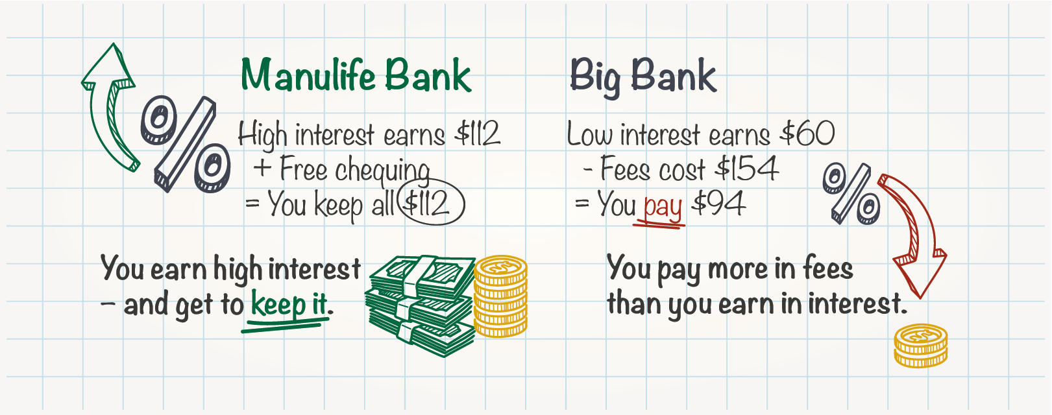
Your clients could earn more and pay less
Compares the outcome of depositing $8,000 into an Advantage Account versus splitting $8,000 between a chequing account and a savings account at a typical ‘big bank’
The end result: With Manulife Bank, you save more than $245 each year!
*Sample illustration” “Big bank” illustration shows a balance of $5,500 in a savings account at 0.70% interest and $2,500 in a chequing account. The illustration compares common daily banking transactions available for free with Advantage Account (when the account balance is $5,000 or higher) to unlimited chequing accounts at most banks that charge a $14 monthly account fee plus a $1 transaction fee per Interac® e-Transfer and $1.50 transaction fee per use of another bank’s ATM. Visit manulifebank.ca for additional details about the features and transactions available for Advantage Account clients.
Notes:
In Canada, typically:
Chequing accounts offer low interest rates, and
Savings accounts require a minimum balance, enforce other restrictions

Slide 8

Bucket Savings
Multiple accounts for tracking savings goals separately (i.e. Saving for a car, a vacation, etc.)
Goals can be long and/or short term
Clients can “nickname” accounts to organize goals
Instantly move money between Manulife Bank accounts with mobile, online or over the phone
Notes:
Multiple accounts can be set up so that the client can have multiple savings goals that they can track in separate accounts (ie. Saving for a car, a vacation, etc.)
Goals can be long and/or short term
Accounts can be nick-named so clients can organize their goals
Easy it is to bank with us as this money can be accessed easily, flexibility with savings, high interest rates
Banking can be easy with us: mobile banking; online banking; large ATM network; etc.

Slide 9
Cash Management
Client’s primary bank account
$1,500 PAC
Use account to eliminate the multiple insurance and investments PACs coming at different times
1 PAC transfer into Advantage Account
Advantage Accounts pays all PACs
Set-up additional buffer to avoid payment disruptions (i.e. rainy day savings)
Can be positioned as white-glove
client service
Advantage Account earning 3.50%*
RRSP
$500 – 3rd of the month
TFSA
$250 – 15th of the month
Life Premium
$300 – 21st of
the month
RESP
$150 – 21st of the month
Extra savings
$300 – ongoing
at 3.50%*
* 3.50% promotional rate is for new deposits to a new personal, non-registered, Canadian-dollar Advantage Account. The promotional interest rate is made up of the regular posted annual variable interest rate of 1.75% and the variable annual promotional rate of 1.75%. Interest is calculated daily and paid monthly beginning on the date the account is opened and continuing 150 days (5 months) on net new deposits to a maximum of $500,000. Any change to the regular interest rate will result in a corresponding change to the promotional interest rate. The offer is limited to one account per client and cannot be combined with other offers. The offer and rates are as of August 24, 2022 and subject to change without notice.
Notes:
Cash Flow Management Tool: Advisors can simplify cash flow management and the management of client finances by setting up an Advantage Account, withdrawal 1 payment at the beginning of the month and have all the PACs for that month come out of the Advantage Account.
The account acts as a cash bucket whilst earning daily interest while it waits to be paid out
Life premiums: For clients that don’t own a home or can’t fit into Manulife One or Select yet; client opens an Advantage Account with every life insurance policy; premiums come out of the account
Rainy day account: Provides a buffer/rainy day fund in case the client loses their job, gets sick or has emergency costs elsewhere so the advisor never has to touch the insurance policy or investments to access cash
Client sets up a PAC into the Advantage Account for 10% more than is needed for the premium; every 10 months, the client will now have a Premium cushion in the account so no Premium ever lapses
Can be positioned as a white glove service
Streamlines paperwork

Slide 10

Estate Planning
At the time of the insurance application, set up an Advantage Account for each beneficiary
Advantage Account can be an estate account
  Family executor can work with the you to manage the estate proceeds instead of a lawyer trust
  Helps you keep assets after the death of a client and may attract the beneficiaries as clients
Notes:
The Advantage Account can be used as an estate account (consider $100,000 can be held outside of probate)
At the time of the insurance application, the advisor can set up an Advantage Account
Profile Manulife Estate Team
Instead of leaving the money in trust at the lawyers, the family executor can work with the insurance advisor to manage the Advantage Account as an estate account; the proceeds of insurance and other investments the deceased client had will get a high interest rate until the lawyers need it for disbursements
This helps advisors keep assets after the death of a client and may attract the beneficiaries as clients

Slide 11

Children’s accounts (minors)
Bridging the next generation of clients
Accounts for minors are opened jointly with a parent (parent is primary)
  If the child has a Social Insurance Number (SIN), they can be listed as primary
Parent gets all Advantage Account banking privileges (online, mobile, cheques, Access Card)
  Child can have an Access Card if permitted
Parents with an Advantage Account can make free transfer funds immediately to child’s account

Slide 12
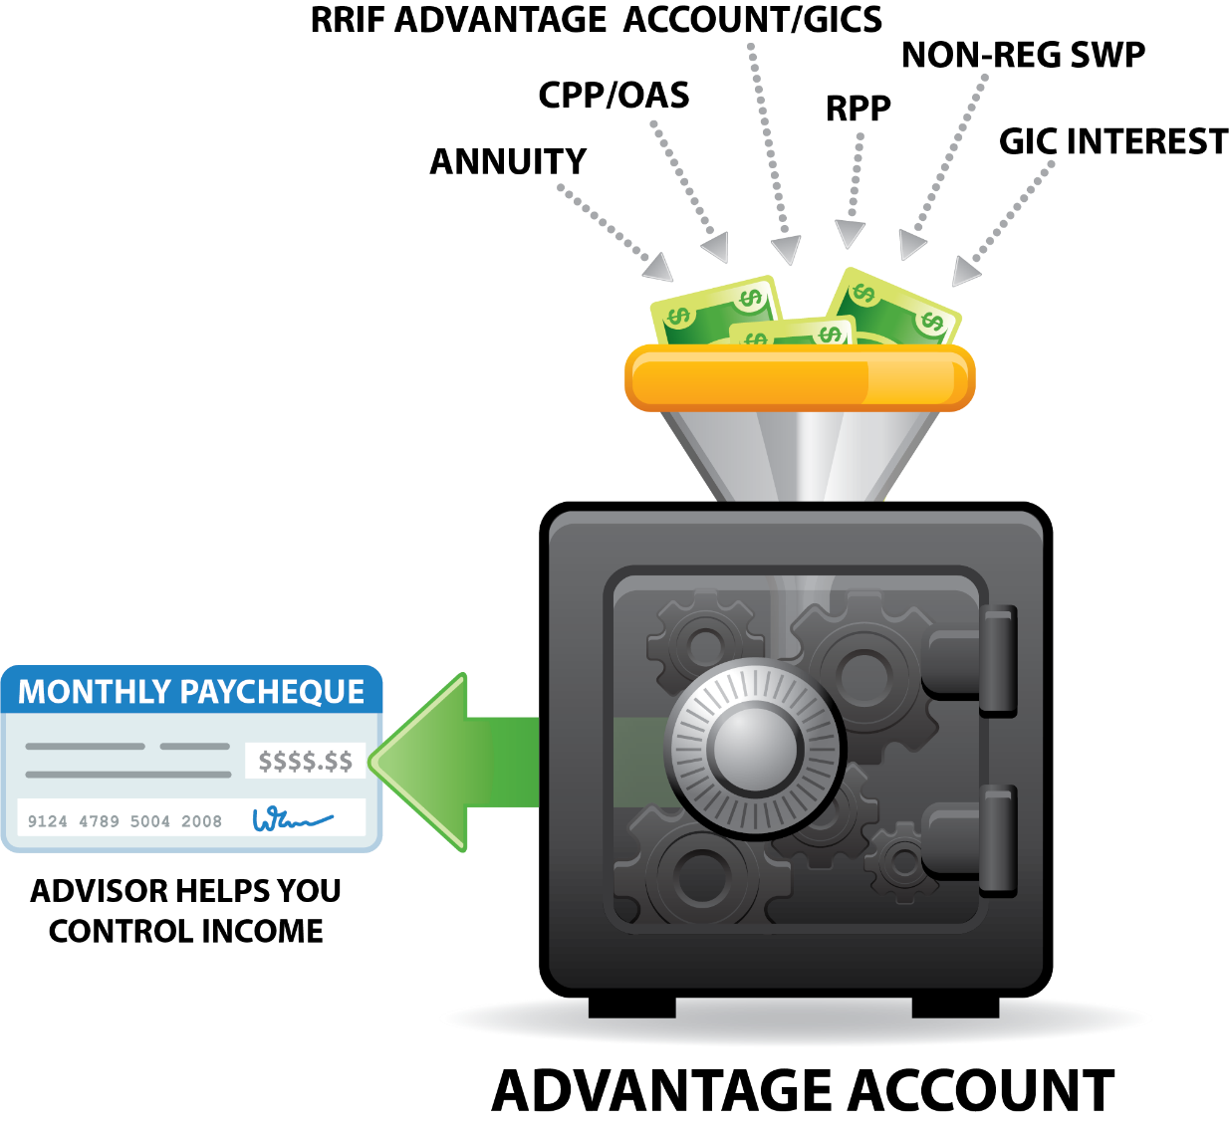
Retirement Income Advantage Account in retirement: Put Manulife Bank first
Advisor helps client consolidate retirement payments
Advisors and clients can know balance daily
Earn high interest on excess
Keep competitors away from client
Client can perform all banking with Advantage Account OR transfer to an existing bank account
Notes:
Now in conjunction with the non-registered Advantage Account, you can help your clients get the most of their retirement income, always earning them a strong short-term interest rate with flexibility to meet their needs.
If they still want to keep their original chequing account, we can help put all deposits to work first and then transfer money to their traditional account.

Slide 13
Positioning of both accounts
RRIF income as needed
RRIF and personal non-registered Advantage Account
  Helping RRIF clients mange low-risk investments required for minimum withdrawal
  Maximize rate of return and flexibility
  Use one deposit application for all RRIF and non-registered accounts (AB0168E)
Retirement Income Advantage Account: 1.25%*
Minimum mandatory
withdrawal.
or income from RRIF Advantage Account as needed
Personal
Non-registered
Advantage Account
3.50%
GIC used only if deposit account does not have enough funds for the minimum required withdrawal
RRIF GIC
4.35%
*As at August 31, 2022,, the variable annual interest rate of 1.25% is applied to all funds in a Retirement Income Advantage Account. Interest is calculated daily on the total closing balance and paid monthly. Rate is subject to change without notice.
* 3.50% promotional rate is for new deposits to a new personal, non-registered, Canadian-dollar Advantage Account. The promotional interest rate is made up of the regular posted annual variable interest rate of 1.75% and the variable annual promotional rate of 1.75%. Interest is calculated daily and paid monthly beginning on the date the account is opened and continuing 150 days (5 months) on net new deposits to a maximum of $500,000. Any change to the regular interest rate will result in a corresponding change to the promotional interest rate. The offer is limited to one account per client and cannot be combined with other offers. The offer and rates are as of August 24, 2022 and subject to change without notice.
***As at August 31, 2022, the annual interest rate of 4.35% is applied to all funds in the Manulife Bank RRIF GIC.
Notes:
100% of clients have a bank account
744 billion in all chequing and savings accounts*
Premium savings accounts – estimated almost $360 billion
Advisors can attract these assets and convert to long term funds if more beneficial to the client
Investments are often personal/Banking is family centric
An estimated $850 billion will transfer through estates in the next decade – proceeds are sent to a bank account
Among widows, 80 per cent switch advisers after the death of their husband.
90% to 95% of offspring leave their parents’ advisors upon receiving their inheritance.

Slide 14
What benefits does Advantage Account have with a RRIF strategy?
RRIF
Advantage Account
CRA
Insurance
Premium / Investments
Notes:
Don’t leave the RRIF income in the hands of a competitor

Slide 15
What benefits does Advantage Account have with a GIC strategy?
GIC #1
GIC #2
RRIF
GIC #3
Advantage Account
Notes:
Multiple GICs?
Different maturity dates?
Different sources?
Get your client’s money ready

Slide 16
Business Advantage Account opportunities
Pays high interest –
no minimums
Liquid –
better than GICs
Great solution for
seasonal income

Slide 17
Business Advantage Account: Put Manulife Bank first
Start with account you can control
Start with account you know balance
Earn high interest on excess
Keep competitors away from client
INSTEAD OF…
WHY NOT?
Operating Account
Business
Advantage Account
Business
Advantage Account
Operating Account

Slide 18
Business Advantage Account:
Tax installment accumulator
Make the most
of your money, before it becomes their money.
Income from
business for self
Tax, CPP, EI
Business
Advantage Account
Pay when
due
CRA
NOTE: Fees apply to electronic bill payments if made online

Slide 19
Business Advantage Account:
Reserve account for improvements/repairs
Make sure the money is there
when needed. Ready cash when emergencies strike.
Great for condo corporations!!!
Business Income
Reserve allotment
Business
Advantage Account
Pay when
needed
Contractor / Supplier
NOTE: Fees apply to electronic bill payments if made online

Slide 20

Business Advantage Account: Charities and Not-for-profit
Premium rates
Accessible
Flexible
Some charities and non-profits are restricted from equity investing
Help businesses and organizations who help others.

Slide 21

Business Advantage Account: Estate Accounts
Life advisors eventually deal with the estate
Lawyers provide accounts but no interest earned
Executors can open account – get guidance
from advisor
Lawyer requests cheques/payments from Executors as needed
Estate earns BAA interest rate
Documents needed
  Copy of Will
  Copy of Death Certificate

Slide 22

Business Advantage Account: Reserve funds or Building fund
Premium rates
Accessible
Flexible
Growing congregations, hospital or college foundations, non-profit organizations, etc.
Make the most of the donors’ money, before it’s needed for the building.
NOTE: Organizations under Sharia Law may not be allowed to earn interest

Slide 23

Business Advantage Account
Offset Operating Account fees
Let Manulife Bank
help pay your client’s business bank fees.
Use your client’s extra cash for
their benefit not their bank’s.
Operating Account
Fees
Bank
Extra cash
Business
Advantage Account
Interest

Slide 24
Helping you share your unique deposit webpage
Email templates, web banners, admats/flyers, social media posts, etc.

Slide 25
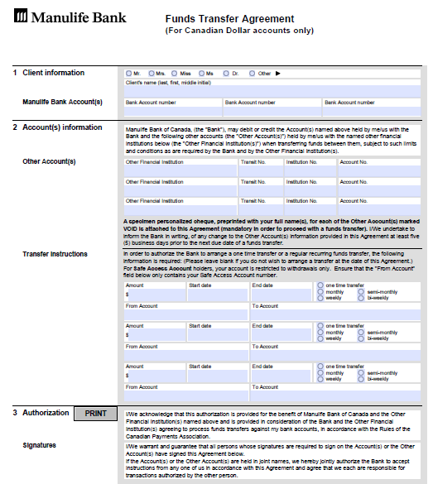
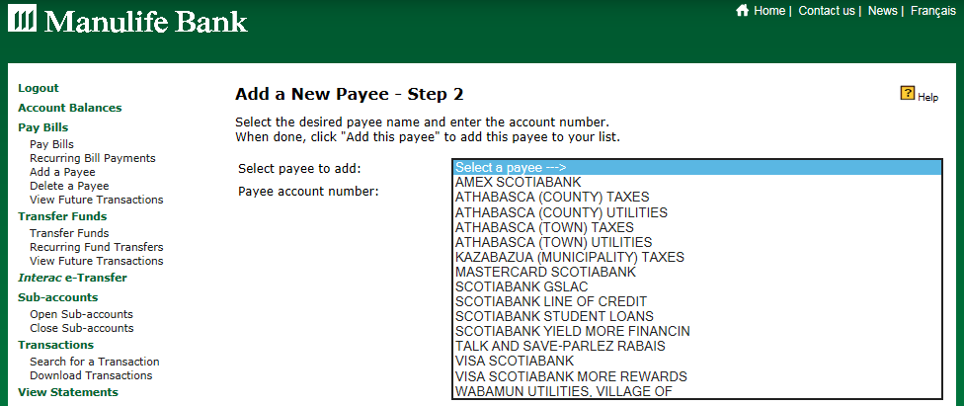
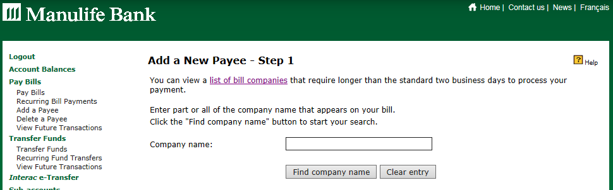
Help your clients make the most of their account
Add bill payments
  Easy to use vendor search
  Add the Bill’s account #
  Save for future payments
Fund Transfer Agreement
  Move money in and out of Advantage Account
  to other bank accounts for free

Slide 26
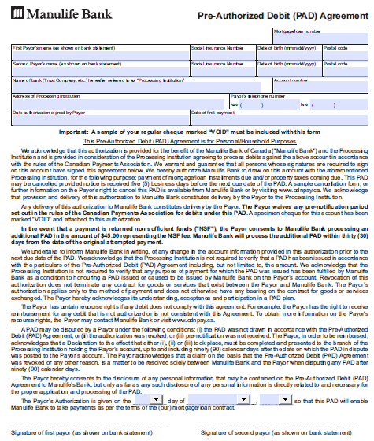
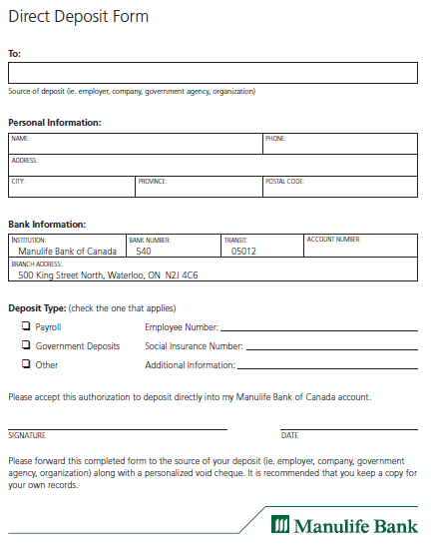
Help your clients make the most of their account
PAD Agreement
  Set-up automatic withdrawals to their investments or other bills
Direct Deposit Form
  Help them earn high interest immediately on every payday

Slide 27
THE BEST-KEPT BANKING SECRET IN CANADA
NO NEED TO BANK ELSEWHERE
SECOND LARGEST CANADIAN ABM NETWORK
EASY ONLINE AND MOBILE BANKING
Mobile Deposit for cheques, access card Interac Flash® tap purchases and voice passwords are industry leading
RANKED AMONG THE BEST FOR CLIENT SERVICE
Traditional banking packages don’t compare to our
all-encompassing banking benefits

Slide 28
Thank you
Notes:
Presenter: Regional Director
Audience: Advisor
Dates and Rates must be updated on the following slides: 4, 8, 10, 13, 14, 15, 16 and 19

Slide 29
Important information
Manulife Bank of Canada is a member of the Canada Deposit Insurance Corporation.
Manulife, Manulife Bank & Stylized M Design, and Stylized M Design are trademarks of The Manufacturers Life Insurance Company and are used by it, and by its affiliates under license

